Slide 1

SpongeBob SquarePants
Episodes Dataset
A Deep Dive into the Nautical Nonsense of SpongeBob Viewership
Notes:
For those of you who don’t know me, hi! My name is Crystal McEnhimer, and the dataset I’m going to explore today is titled “the spongebob squarepants episode dataset”. And it’s exactly what it sounds like

Slide 2
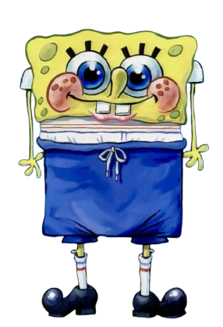
Introduction and Summary
Detailed information about the episodes in seasons 1-14 of SpongeBob SquarePants
Dataset from Kaggle:
https://www.kaggle.com/datasets/myticalcat/spongebob-squarepants-episodes-dataset?resource=download

Slide 3

25 total columns, 7 utilized
'Airdate', 'Animation', 'Animation Supervisor', 'Copyright year', 'Creative', 'Episode №', 'Guest(s)', 'Line Producer', 'Main', 'Next', 'Previous', 'Production code', 'Running time', 'Season №', 'Sister episode(s)', 'Storyboard', 'Storyboard Artist(s)', 'Supervising', 'Supervising Producer(s)', 'Technical', 'U.S. premiere time (ET)', 'U.S. viewers (millions)', 'Writer(s)', 'characters', 'title'
Notes:
There were 25 columns within this dataset, ranging everywhere from the year the episode was copyrighted, to the episode’s premiere time in the US, to every single character that ever graced the screen. In excruciating detail. But, for the purposes of this exploration, we’re going to focus on 8 main columns.
#There’s a short, 3 minute episode where spongebob uses a “reef blower”, which is the undersea equivalent of a leaf blower, and they listed the reef blower as a character. #All that to say, they didn’t spare any details when compiling this dataset. I chose to focus on 7 main columns

Slide 4

The Big 7:
Categorical Variables:
'Animation'
'Writer(s)'
'Supervising Producer(s)'
'characters'
Numeric Variables:
'U.S. viewers (millions)'
'Episode №'
'Season №'
Notes:
These columns are comprised of 4 categorical variables, which are the names of every animator, writer, and producer that worked on the episode, and the name of every character that appeared. The 3 numeric variables are the episode and season number, and the number of viewers for this episode.

Slide 5

Research Question
What factors in this dataset have an impact on the success of the episode, in terms of viewership?
Characters included?
Animators/writers?
Chronological series order?
Notes:
The data brings us to our research question. What factors in this dataset have an impact on the success of the episode, in terms of viewership? Is it the characters in the episodes, is it the creatives involved in making the episode, are there spikes in popularity based on the time period or season? There’s so many things that could impact the success of these episodes, so we’re going to look into the formula that has created success for this show over the last 26 years.

Slide 6
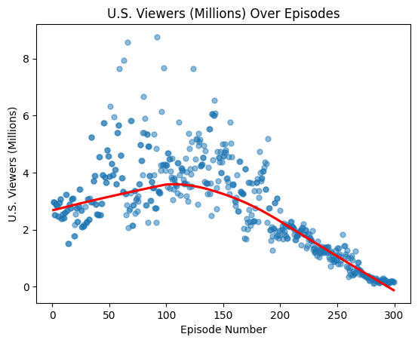
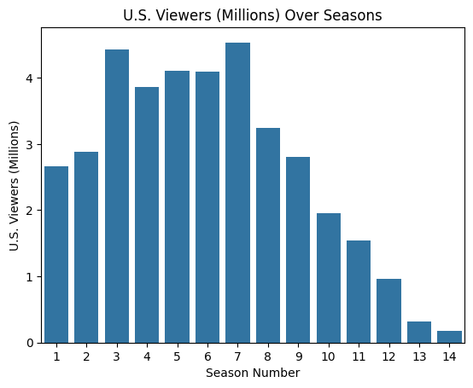
SpongeBob Viewership Over Time
Notes:
So, we’ll start very surface level with the simplest question: when was the series most popular? How has its popularity changed over time?
If you consider the plot on the left, you can see that as the episode # increases, so does viewership up until around episode 125, and it then consistently decreases from then on. There are some insanely good, iconic episodes that exist as outliers and drew up the average viewership for their season, but those become sparser as time progresses and cease to exist entirely by episode 200. So the show peaks in popularity around season 7, and significantly drops off from there. Now what causes this to happen?

Slide 7
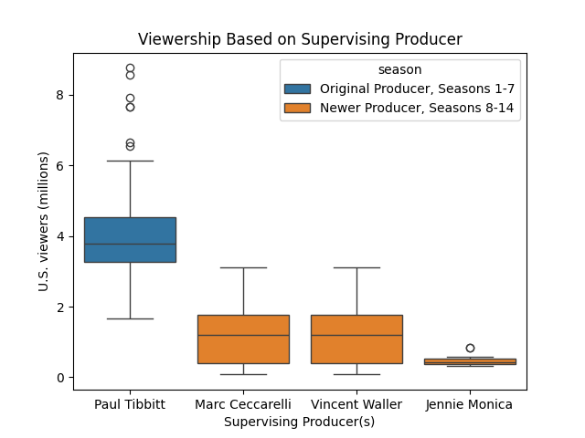
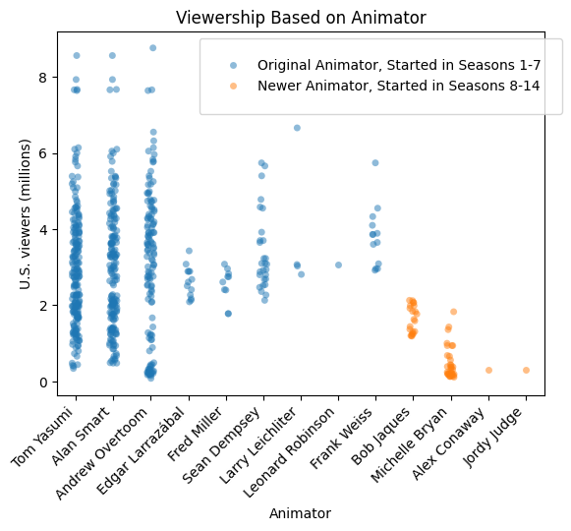
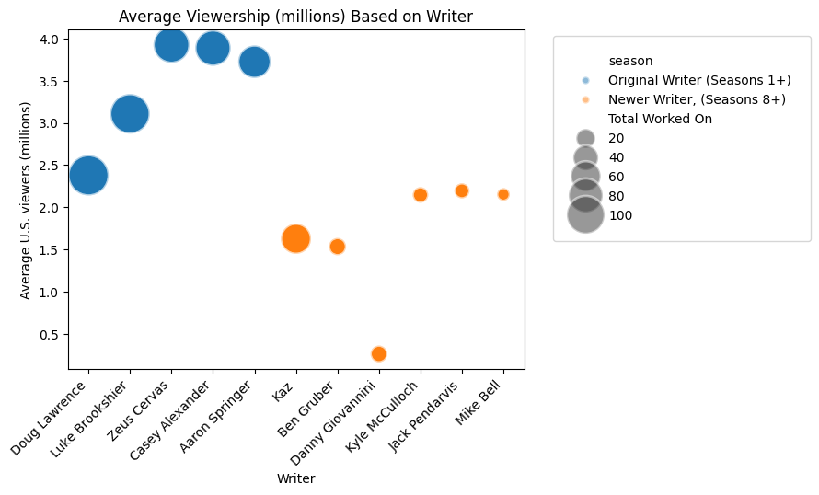
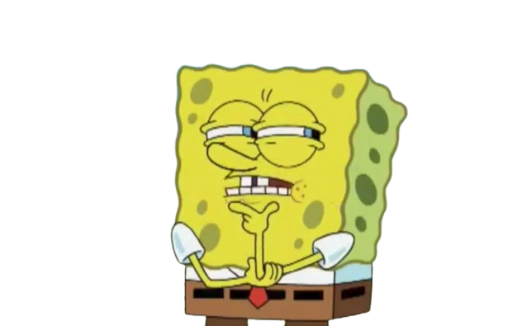
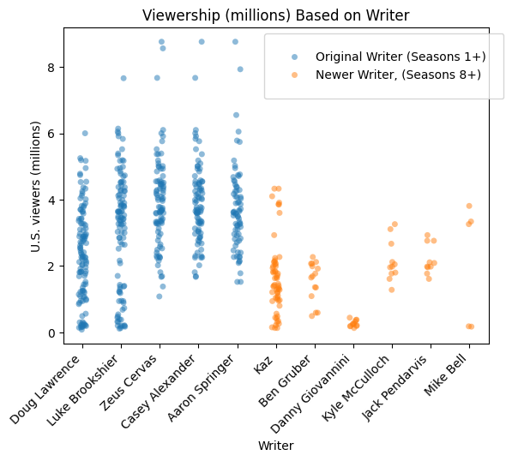
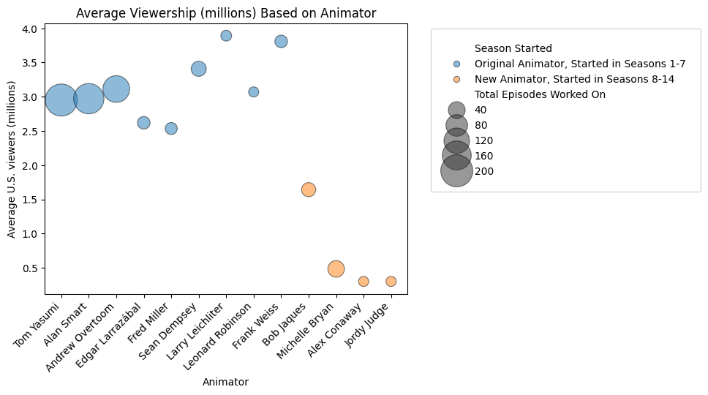
The Impact of the Creative Minds Behind SpongeBob
Notes:
The answer lies in the creative minds behind the show. The graphs on the page explore the change in producers, animators, and writers of the show. As you can see, there’s a large separation between the blue variable, creatives who started in seasons 1-7, and the orange column, creatives that started in seasons 8-14. In all of these categories, the creatives of the earlier seasons found more success and higher viewer counts upon their episode’s premiere. These variables appear to be significantly correlated, which tells us the creatives behind spongebob likely have a significant impact on the series’ success.
We’re going to explore four different variables, and how they impact the viewership of this show, starting with the animator. This plot demonstrates the contrast between the long-time animators who were with the show from the beginning and stayed for the majority of the show, and the newer animators that started around/after the time of the show’s decline. You can see in this graph that the newer animators don’t have very successful episodes whatsoever, while the older animators have a wide variety of successes and failures, centered around 3-4 million views per episode. Their range is larger, but
We’re going to explore four different variables, and how they impact the viewership of this show, starting with the animator. This plot demonstrates the contrast between the long-time animators who were with the show from the beginning and stayed for the majority of the show, and the newer animators that started around/after the time of the show’s decline. You can see in this graph that the newer animators don’t have very successful episodes whatsoever, while the older animators have a wide variety of successes and failures, centered around 3-4 million views per episode. Their range is larger, but

Slide 8
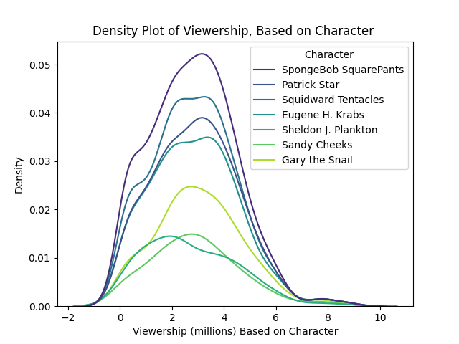

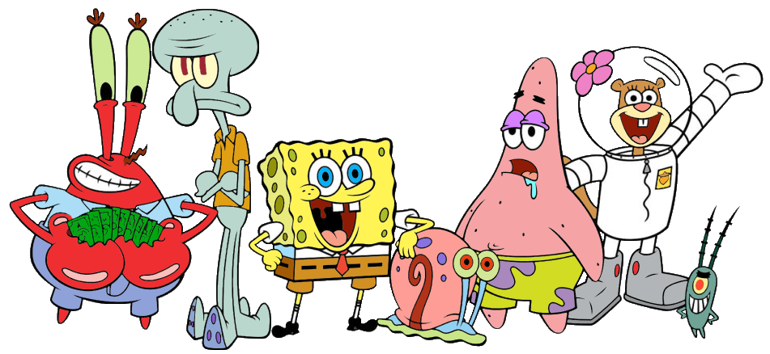
What Else Drives This Change?
'Animation'
'Writer(s)'
'Supervising Producer(s)'
'characters'
Notes:
The characters in the show, however, do not appear to have a significant impact on the viewership of the show. This plot shows us that some characters (like SpongeBob) appear more frequently in the series, but each of these density curves have a similar shape and are centered around the same point, meaning the viewership doesn’t deviate much with the appearance or disappearance of a character.

Slide 9

What About our Research Question?
What factors in this dataset have an impact on the success of the episode, in terms of viewership?
Of our variables of interest, only episode/season, animator, writer, and supervising director appear to have an impact on the viewership of an episode upon
its airing.
Correlation =/= causation! The
significance of these variables could
be due to any number of things, and
does not guarantee a relationship!
Notes:
Maybe these variables do influence one another! Or maybe
Maybe inevitable decline like every good show must

Slide 10
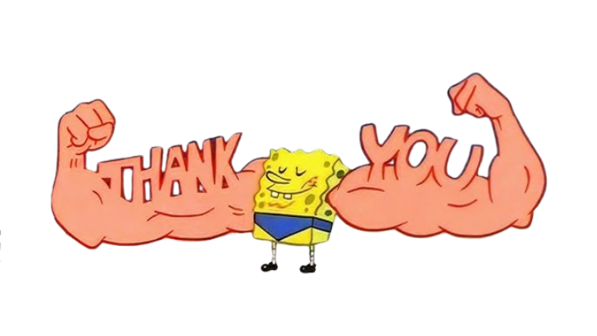
Any Questions?

